Slide 1
Chapter 2
Basic Structures
Sets, Functions
Sequences, and Sums

Slide 2
Objectives
Sets
Set operations
Functions
Sequences
Summations

Slide 3
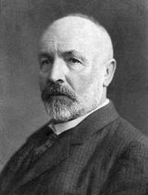
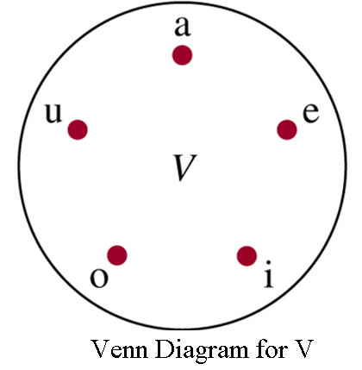
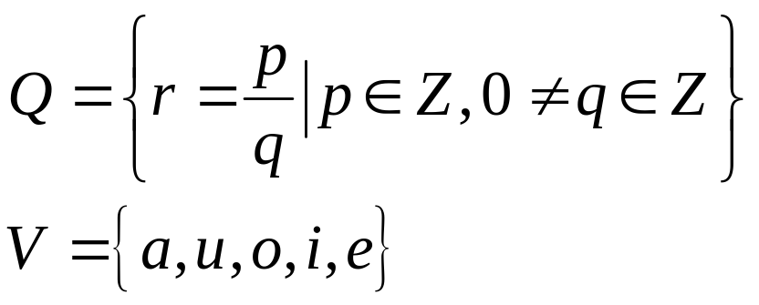
2.1- Sets
An unordered collection of objects
The objects in a set are called the elements, or members. A set is said to contain its elements.
Some important sets in discrete mathematics
  N = { 0,1,2,3,4,… }
  Z = { … , -2,-1,0,1,2,…} Z⁺ = {0,1,2,…}
  R: the set of real numbers
  a∈A : a is an element of the set A // a belongs to A
  a∉A: a is not an element of A
G. Cantor
Notes:
GEORG CANTOR (1845-1 918), the father of set theory.

Slide 4

Sets…
Definitions:
Finite set: Set has n elements, n is a nonnegative integer
A set is an infinite set if it is not finite
Cardinality of a set |S|: Number of elements of S
 : empty set (null set), the set with no element
Two sets are equal ←→ they have the same elements
A = B if and only if ∀x (x∈A ↔ x∈ B)
A⊆ B: the set A is a subset of the set B
A ⊆ B if and only if ∀x (x∈A → x∈ B)
A ⊂ B: A is a proper subset of B
A ⊂ B if and only if (A ⊆ B) ^ (A ≠ B)
Venn diagram shows that A is a subset of B
Notes:
No confusion between two sets {} and . The first set has one element, the second set has no element.

Slide 5
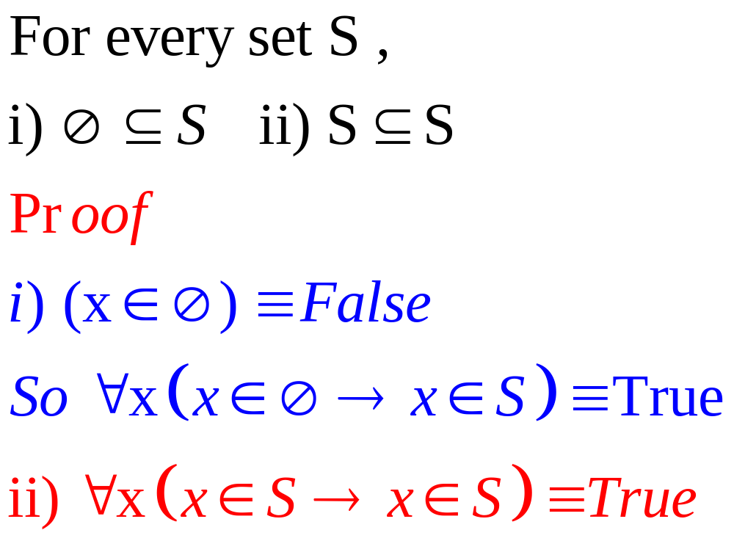
Theorem 1

Slide 6



Slide 7


Slide 8
Power Sets
Given a set S, power set P(S) of S is a set of all subsets of the set S.
S= { 1,2,3}
P(S)= {Ø,
{1}, {2},{3},
{1,2}, {1,3},{2,3},
{1,2,3}}
Notes:
If the set S has n elements, then the power set P(S) has 2^{n} elements.
No confusion between “subsets” and “element” when dealing with a power set. Every “subset” of S is an “element” of P(S) (the power set of S).

Slide 9
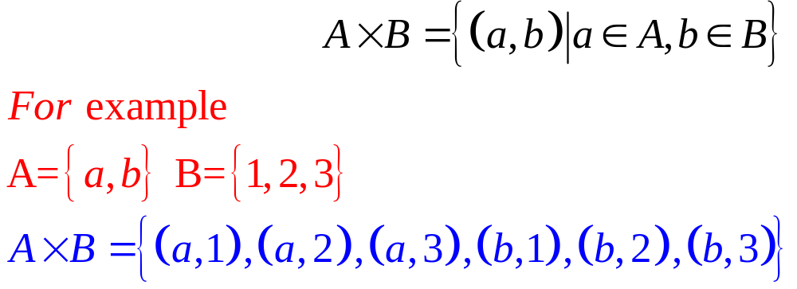
Cartesian Products
The ordered n-tuple (a₁,a₂,…,a_{n}) is the ordered collection that has a₁ as its first element, a₂ as its second element, …, and a_{n} as its n^{th} element.
Let A and B be sets. The Cartesian product of A and B, denoted by AxB,
Notes:
The word “ordered” is important. That means, (a , b) and (b, a) are not equal unless a = b.
In general, AB is different from BA.
Note that if A or B is empty, then AB and BA are also empty.
A subset R of the Cartesian product AB is called a relation from A to B. We will study relations in the Chapter 8.

Slide 10
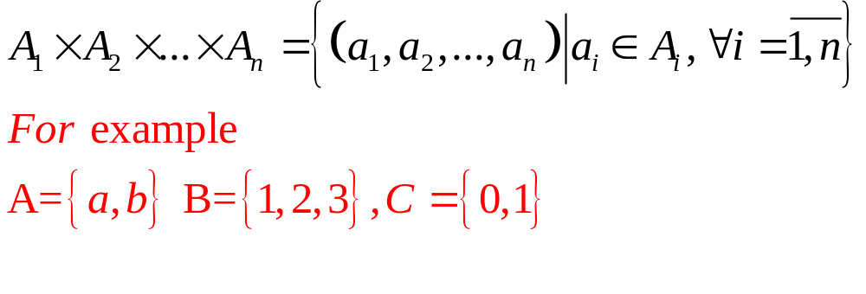
Cartesian Products…
The Cartesian product of A₁,A₂,…,A_{n} , denoted A₁xA₂x…xA_{n}, is the set of ordered n- tuples (a₁,a₂,…,a_{n}),
AxBxC= {(a,1,0),(a,1,1),(a,2,0),(a,2,1),(a,3,0),(a,3,1),
(b,1,0),(b,1,1),(b,2,0),(b,2,1),(b,3,0),(b,3,1) }

Slide 11
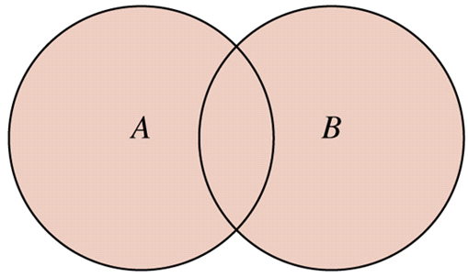
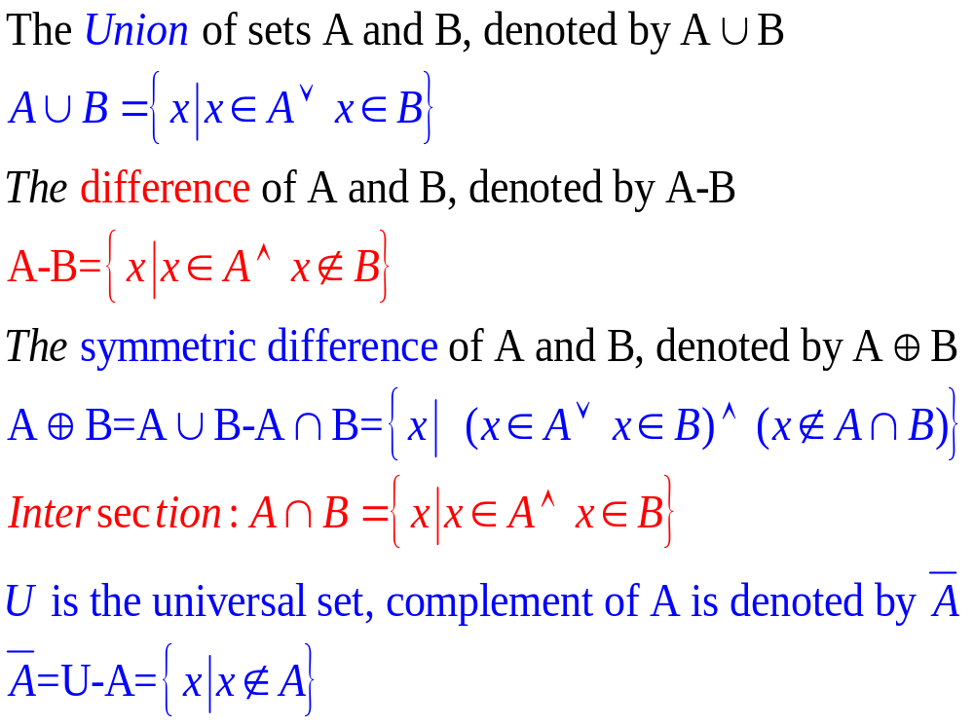
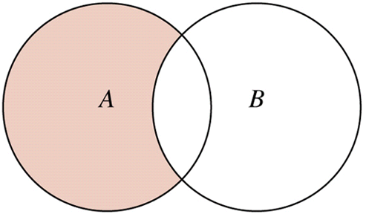

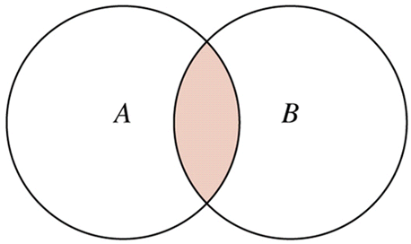
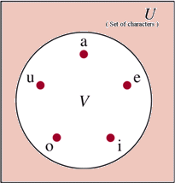
2.2- Set Operations
Notes:
- The difference of A and B is also called the complement of B with respect to A.

Slide 12

Set Identities
Identity – See proofs : pages 125, 126 | Name
A ∪ = A A∩ U = A | Identity laws
A ∪U= U A ∩ =  | Domination laws
A ∪A=A A∩A=A | Idempotent laws
 | Complementation law
A∪B = B ∪ A A∩B=B ∩A | Commutative laws
A∪ (B∪ C) = (A ∪B) ∪ C A∩ (B ∩ C)= (A ∩B) ∩ C | Associative laws
A∩ (B ∪ C) = (A ∩B) ∪(A ∩ C) A ∪ (B ∩C) = (A ∪ B) ∩(A ∪ C) | Distributive laws
A ∪ B = A ∩ B A ∩B = A ∪ B | De Morgan laws
A ∪ (A ∩B) = A A ∩ (A∪B) = A | Absorption
A ∪ A = U A ∩‾A =  | Complement laws
Notes:
Note that some students forget using De Morgan Laws to form complements of sets. They sometimes make similar errors in propositional logic, such as, incorrectly, that ➢(p  q)  ➢p  ➢q.

Slide 13
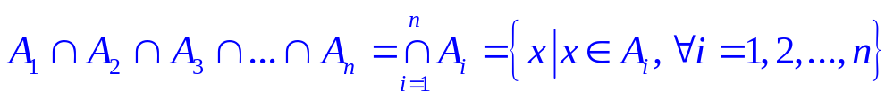
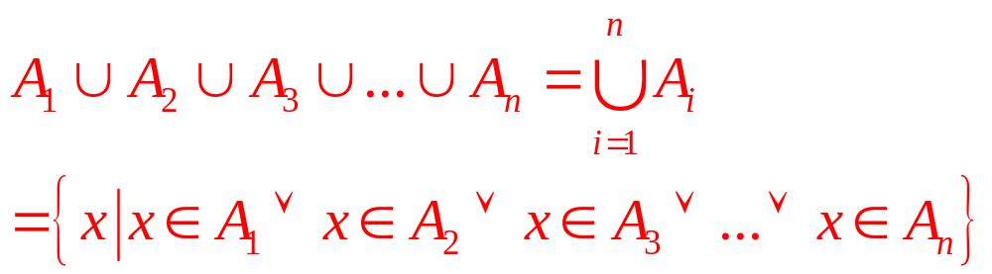
Generalized Unions and Intersections
Computer Representation of Sets
Use bit string U={1,2,3,4,5,6,7,8,9,10}
A= {1,3,5,7,9 } ➔ A = “1010101010”
B= { 1,8,9} ➔ B = “1000000110”
Notes:
- The universal set U is represented by the string 1111111111

Slide 14
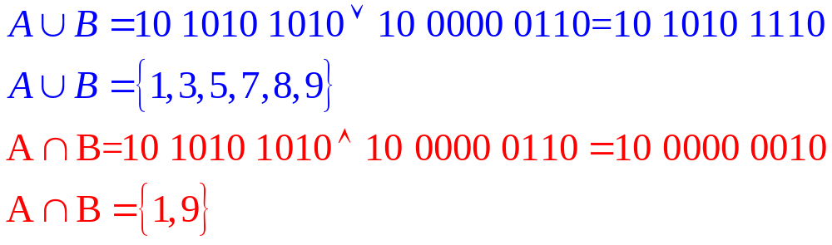
Computer Representation of Sets
A = “1010101010”
B = “1000000110”
Notes:
Suppose that two sets A and B are represented by the strings a_{i} and b_{j}.
The string c_{i} representing the union of A and B can be found as: for all values of i, if a_{i} = b_{i} =0 then c_{i} = 0 else c_{i} = 1.
The string c_{i} representing the intersection of A and B can be found as: for all values of i, if a_{i} = b_{i} =1 then ci = 1 else c_{i} = 0.
The string c_{i} representing the complement of A can be found as: c_{i} = 1-a_{i}.

Slide 15
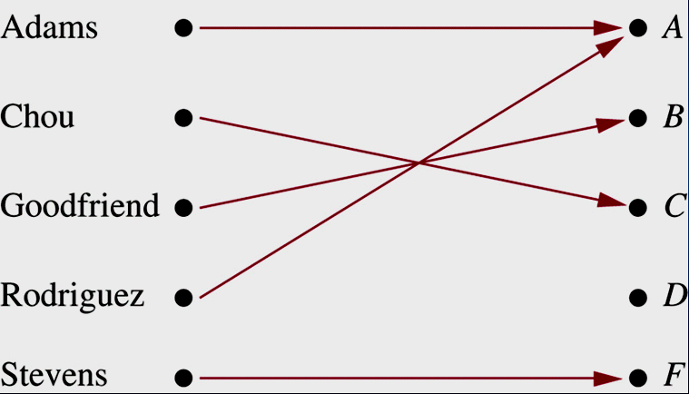
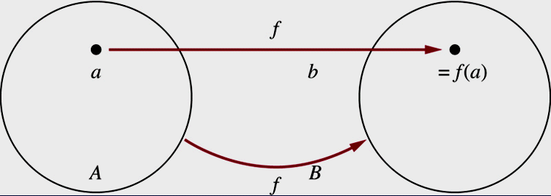
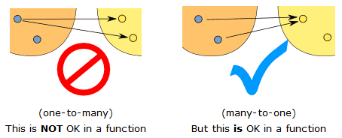
2.3. Functions / Mappings / Transformations…
f: A → B : function f from A to B (or function f maps A to B)
A: domain of f
B: codomain of f
Notes:
The function f: A B is not A, it is not B, it is not an element of A or B. It is not an action on just one element of A.
The function f: A B means that f is a rule that apply to every element of A and in each case yield EXACTLY ONE result in B.
The function f: R R, f(x) = x² is a many-to-one action, but f: R R, f(x) = ±x is not a function (one-to-many action).

Slide 16
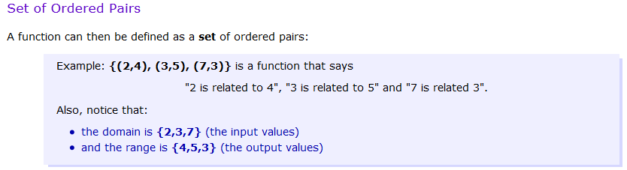
Functions as sets of ordered pairs

Slide 17
Functions / Mappings / Transformations…
What are functions?
f: → ○ : f(x) = x² + 2
f: → ○ : f(x) = 1/(x-1)² + 5x
f: ○→ ○ : f(x) = (2x+5)/7
f: → ○ : f(x) = (2x+5)²/(7-2x)
Notes:
f: → ○ : f(x) = 1/(x-1)² + 5x is not a function because f cannot apply to 1.
f: → ○ : f(x) = (2x+5)²/(7-2x) is a function. Note that domain of the function is . So, 7-2x is nonzero.

Slide 18
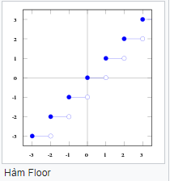
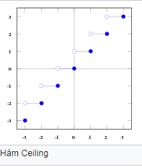
Some Important Functions
See Figure 10 – Page 143
Floor function
f: ○ → such that f(x)= ⎣x⎦ = largest integer that less than or equal to x, ⎣x⎦ x
Ceiling function
f: ○ → such that f(x)= ⎡x⎤ = smallest integer that greater than or equal to x, x ⎡x⎤
Notes:
- Floor and ceiling functions always produce integers.

Slide 19
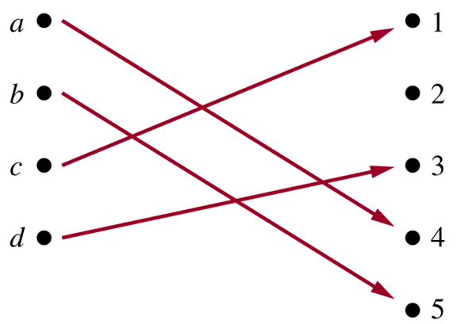
One-to-One/ Injective functions
Function f is one-to-one (or injective) if and only if
a  b → f(a)  f(b)
for all a and b in the domain of f.
f :  → , f(x) = x²
f is not one-to-one
(we have f(-1) = f(1))
Notes:
On-to-one function is a function that all images are different.
One-to-one: a b (a  b  f(a)  f(b))  a b (f(a) = f(b)  a = b).
Not one-to-one: a b (a  b  f(a) = f(b)).

Slide 20
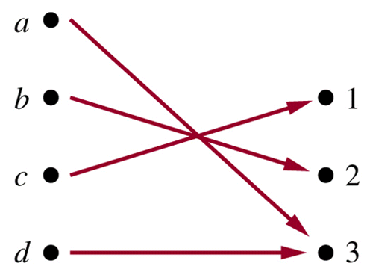
Onto Functions
A function f from A to B is called onto, or surjective, iff
for every element b in B there is an element a in A with f(a)=b.
f:  → , f(m) =m-1
f is onto because ∀y∈ , y=f(m)=m-1, where m=y+1
Notes:
f: A  B is onto if yBxA (f(x) = y).
f: A  B is not onto if yBxA (f(x)  y).

Slide 21
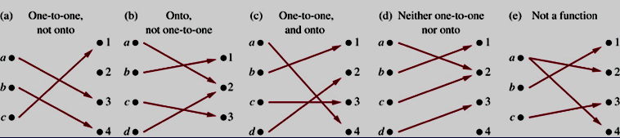
One-to-one Correspodent / Bijective
Functions
Function f is a one-to-one corespondence or a bijection if it is both one-to-one and onto.
f: {A,B,…,Z} →{65,66,…,90} is a bijection

Slide 22
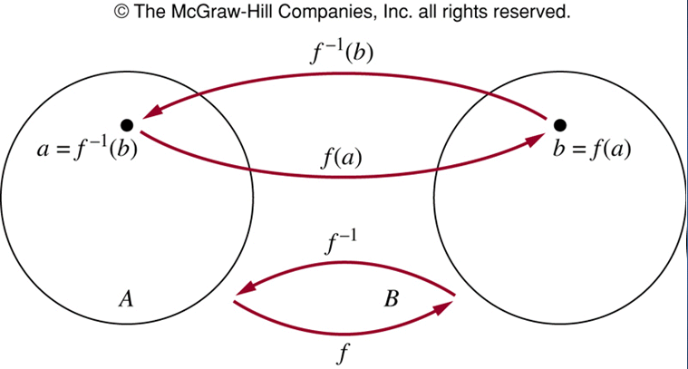
Inverse Functions
Let f is a bijection from A to B. The inverse function, denoted by f⁻¹, of f is the function that assigns to an element b belonging to B the unique element a in A such that f(a)=b. Hence f⁻¹(b)=a when f(a)=b.
Notes:
Note that f⁻¹ is NOT 1/f, which is defined by (1/f) = 1/f(x). For example, if f(x) = 2x + 3 then (1/f)(x) = 1/(2x+3), but f⁻¹(x) = (x-3)/2

Slide 23
Inverse Functions…
f:→ such that f(x)=x+1
Is f invertible? And if it is, what is its inverse?
Step 1: Show that f is onto
f(y-1)=y for all y
➔ f is onto
Step 2: Show that f is one-to-one
f(a)=a+1= f(b)=b+1 ➔ a=b ➔ f is one-to-one
f is bijection ➔ f is invertible
Step 3: Find inverse function
f(x)= y=x+1 ➔x=f⁻¹(y)
x=y-1 ➔ f⁻¹(y)=y-1

Slide 24
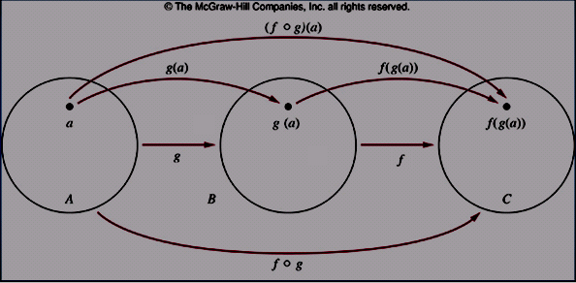
Composition of Functions
Let g:A → B, f: B → C
The composition of f and g, denoted by f□g, is defined by: (f□g)(x)= f(g(x))
Example:
f:  →, f(x)=x+1
g:→, g(x)= x²
(f□g)(x)= f(g(x))= f(x²) = x²+1
(g□f)(x) = g(f(x)) = g(x+1)= (x+1)²
Notes:
- If a function f is invertible and f⁻¹ is the inverse function of f, then (f□f⁻¹)(x) = x and (f⁻¹□f)(x) = x.

Slide 25
2.4- Sequences
Sequence : a₁, a₂, a₃,…, a_{n},…
  Ex: 1,3,5,8 : Finite sequence
  Ex: 1, 1, 2, 3, 5, 8, 13,… : Infinite sequence
A sequence is a function from a subset of integers to a set S.
a_{n} : image of the integer n
a_{i} : a term of the sequence
{a_{n}= 1/n}: ₊→ ○ ➔ 1, 1/2, 1/3, 1/4, …

Slide 26
Sequences…
Geometric progression
f(n) = ar^{n} ➔ a, ar, ar², ar³, …, ar^{n}
Arithmetic progression
f(n) = a + nd ➔ a, a+d, a+ 2d, … , a+nd
a: initial term,
r: common ratio, a real number
d: common difference, real number
Do yourself
b_{n}= (-1)^{n} , n>=0 c_{n}= 2(5)^{n} , n>=0
t_{n}= 7-3n, n>=0 a_{n}= -1 + 4n, n>=0

Slide 27
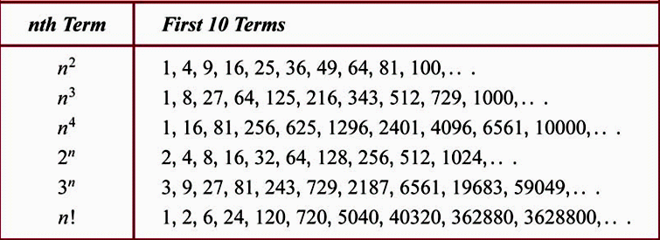
Some Useful Sequences

Slide 28
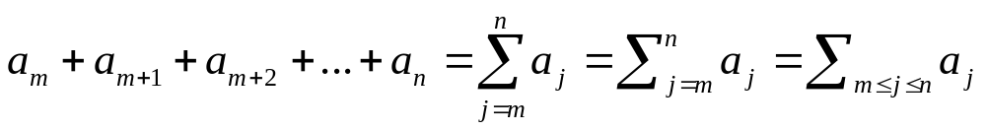
Summations
// 1 + 2 +3+4+…+n
long sum1 ( int n) // n additions
{ long S=0;
for (int i=1; i<=n; i++) S+= i;
return S;
}
// 1 addition, 1 multiplication, 1 division
long sum2 (int n)
{ return ((long)n) * (n+1)/2;
}
a : Sequence
j : Index of summation
m: Lower limit
n : Upper limit
See examples 10, 11. Page 154

Slide 29
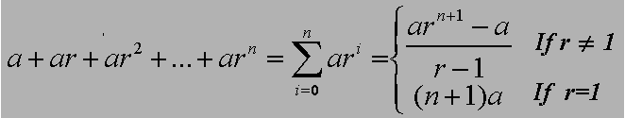
Summations….
Theorem 1- (Summation of geometric series)
See the proofs in page 155

Slide 30
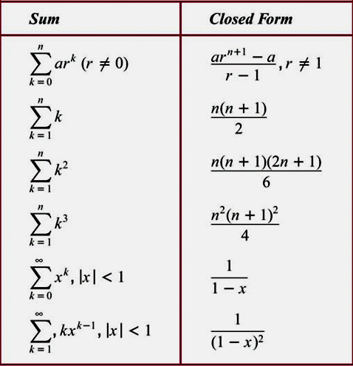
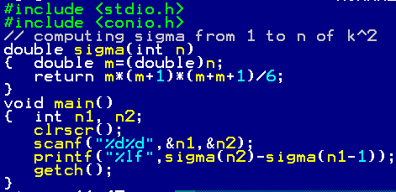
Some Useful Summation Formulae
See example 15, page 157

Slide 31
Cardinality
Cardinality = number of elements in a set.
The sets A and B have the same cardinality if and only if there is a one-to-one correspondence from A to B
A set that is either finite or has the same cardinality as the set of positive integers is called countable.
A set that is not countable is called uncountable.
When a infinite set S is countable, we denote the cardinality of S is |S|= א₀ (aleph null)
For example, | א₀ because  is countable and infinite but ○ is uncountable and infinite, and we say |○^{ א0}
Notes:
- The function f:{0, 1, 2, 3, …}  {0, 2, 4, 6, …}, f(m) = 2m is a bijection. So, {0, 1, 2, 3, …} has the same cardinality as {0, 2, 4, 6, …}.

Slide 32
Examples p.159, 160
sets | countable | uncountable | cardinality
{a, b, …, z}, {x| x⁵ -3x² – 11 = 0}, … | ✓ | ✗ | < 
{0, 2, 4, …, } | ✓ | ✗ | א₀
N, Z⁺, Z, Q, ZZ, … | ✓ | ✗ | א₀
{x| 0 < x < 1}, R,… | ✗ | ✓ | 2^{א0}
Notes:
- Cardinalities of some countable/uncountable sets.

Slide 33
Summary
Sets
Set operations
Functions
Sequences
Summations

Slide 34
Thanks

